Slide 1
MEDISYNC: SMART MEDICATION MANAGEMENT FOR ELDERLY INDEPENDENCE
35035
Problems of Elderly
daxspidy@gmail.com
GTHS VARAPPETTY
ERNAKULAM

Slide 2


PROBLEM STATEMENT
The elderly face significant challenges in adhering to medication schedules due to cognitive decline, confusion, or physical limitations like reduced dexterity. These issues can result in missed doses, incorrect medication intake, or inconsistent timing, all of which jeopardize their health. Managing multiple medications adds complexity to their daily routines, especially for those dealing with chronic health conditions. Social isolation and the lack of a reliable support system exacerbate these problems..

Slide 3

IDEA SUMMARY / APPROACH
MediSync is an automatic pill dispenser that works in conjunction with a phone-based notification system. It provides timely, accurate doses to elderly individuals and ensures reminders are sent to their smartphones or to their caregivers when needed. The device reduces reliance on memory and physical ability by automating the dispensing process, ensuring that users always receive their medications at the correct time and in the correct dosage

Slide 4

PRODUCT/SOCIAL CAUSE/RESEARCH
MediSync is a product aimed at enhancing the independence of elderly individuals by allowing them to manage their medication schedules without requiring caregiver involvement for every dose.
Who benefits: Direct beneficiaries include elderly individuals with cognitive or physical challenges. Indirect beneficiaries are caregivers and healthcare providers who will have reduced concerns about missed or incorrect doses

Slide 5
Unique Aspect: The combination of a physical dispenser with a digital notification system is what sets MediSync apart from existing solutions. This dual-layer approach ensures better adherence to medication schedules and provides peace of mind to caregivers through remote monitoring features.
Previous Solutions: While other medication dispensers and reminder apps exist, few offer the seamless integration of both physical and digital solutions for elderly individuals.

Slide 6
PROJECT STATUS
Project Status MediSync is currently in the prototype stage, with an initial design being tested for usability among a small group of elderly users. The feedback from this test phase will be used to refine the product before further development and scaling.
IP Status: No patent has been filed as of yet, but plans are in place to file once the prototype is finalized.

Slide 7
VOICE OF STAKEHOLDER SURVEY
Stakeholders/Customers: The primary stakeholders include elderly individuals, caregivers, and healthcare providers.
Survey Findings: While no formal surveys have been conducted, initial conversations with potential users suggest a strong need for such a solution. Elderly individuals and their caregivers expressed the desire for a product that reduces the mental load of managing complex medication regimens.

Slide 8
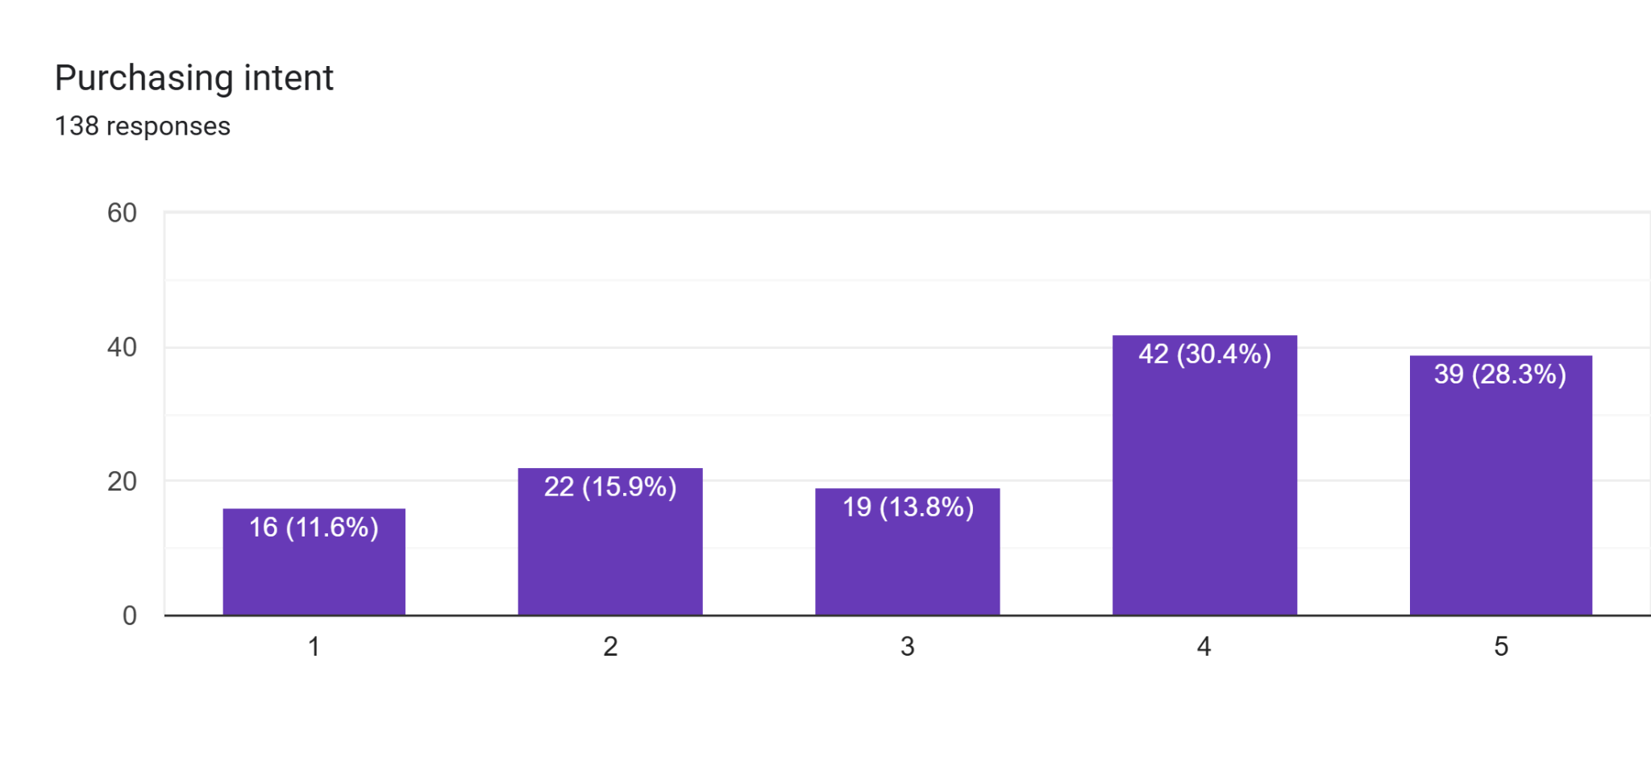

Slide 9
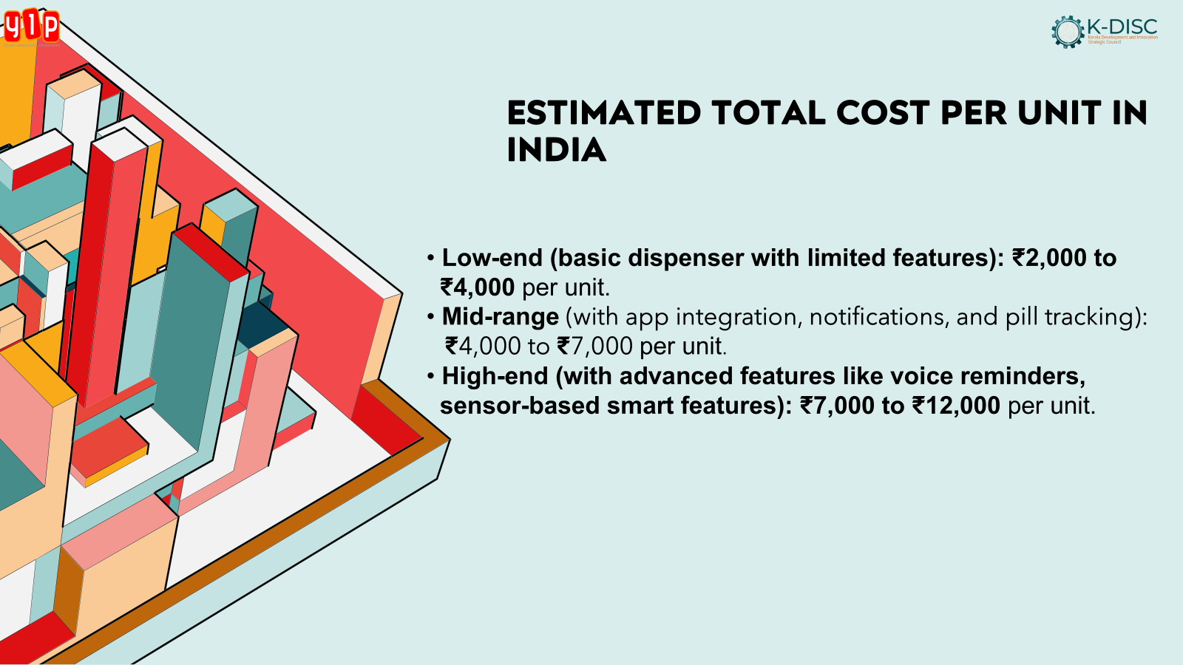
VOICE OF STAKEHOLDER SURVEY
Stakeholders/Customers: The primary stakeholders include elderly individuals, caregivers, and healthcare providers.
Survey Findings: While no formal surveys have been conducted, initial conversations with potential users suggest a strong need for such a solution. Elderly individuals and their caregivers expressed the desire for a product that reduces the mental load of managing complex medication regimens.

Slide 10
COMPETITORS?
Competitors Existing solutions, such as pill organizers and reminder apps, do not fully cater to the needs of elderly individuals with cognitive and physical limitations.
Niche Area: MediSync's niche lies in its dual solution of automatic dispensing combined with digital notifications, allowing users to stay on track with medication without manual intervention.
How it Addresses the Niche: Unlike simple pillboxes, MediSync ensures that the user takes the correct dose at the correct time, with built-in reminders and emergency alerts for missed doses.

Slide 11
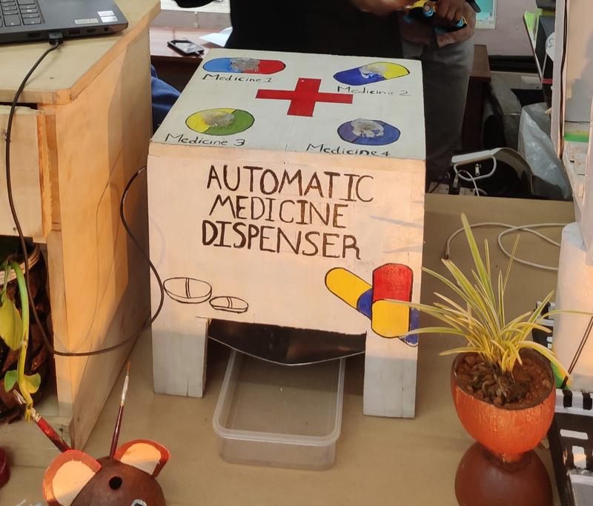
DRAWING OF YOUR PRODUCT OR TECHNOLOGY USED

Slide 12
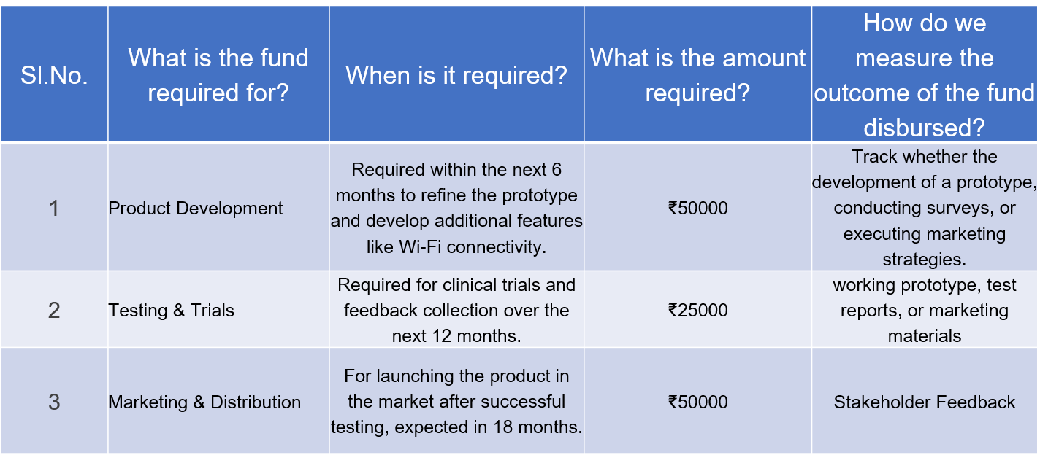
INVESTMENT/SUPPORT NEEDED PLEASE OUTLINE THE TOTAL FUND REQUIRED AND THE SPLIT

Slide 13
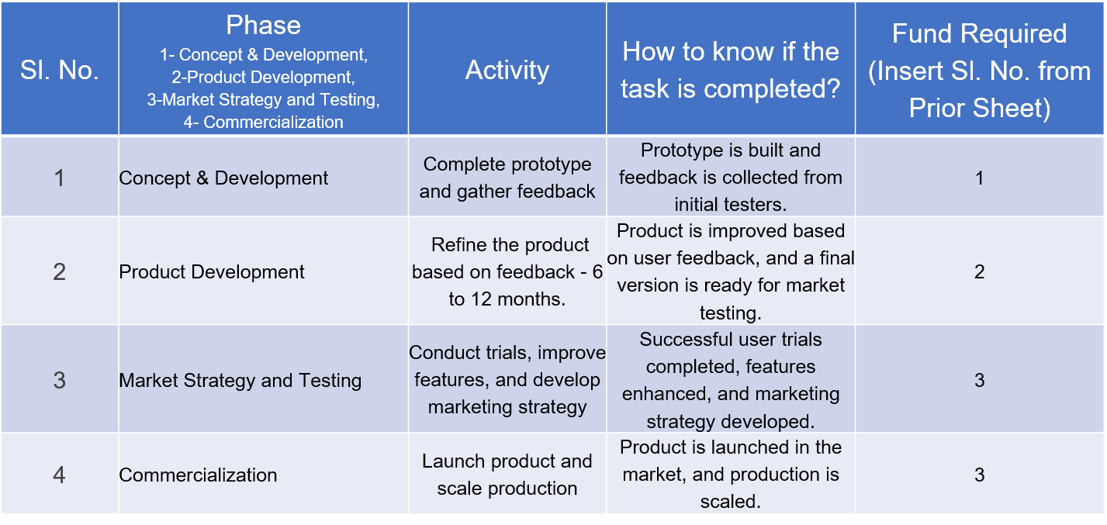
PROJECT SCHEDULE

Slide 14
IMPACT
Outcome: MediSync is expected to significantly improve medication adherence among elderly users, resulting in better health outcomes and reduced hospital visits.
Revenue Model: MediSync will generate revenue through direct product sales, subscriptions for app-based features, and potential partnerships with healthcare organizations.
Social Impact: The solution will empower elderly individuals to live more independently, reducing the burden on caregivers and the healthcare system.

Slide 15



TEAM OVERVIEW
Muhammed Faris PS
Jeevan Joy
Dhivin Pratheesh
The MediSync team consists of experts in healthcare, product design, and app development, all working collaboratively to address the challenges elderly individuals face in managing medications independently

Slide 16
ADDITIONAL INFORMATION
Potential Partnerships: Consider partnering with healthcare providers, elderly care facilities, or medical device companies to enhance product reach and credibility.
Regulatory Compliance: Ensure that the product complies with healthcare regulations such as FDA (in the U.S.) or CE marking (in Europe), which will be crucial for clinical trials and commercialization.
Long-Term Vision: Beyond the initial prototype, consider expanding MediSync's features to include integration with health monitoring systems (e.g., blood pressure or glucose monitoring), allowing for a comprehensive elderly care solution.
Risk Management: Include contingency plans for potential delays in product development or trials, along with backup funding strategies in case of budget overruns.
Future Funding Requirements: After the initial commercialization, additional funds may be required for scaling production, entering new markets, or enhancing product features based on user feedback.

Slide 17
THANK YOU

